Slide 1
Invisible Connections:
Introduction to Parasitic Plants
Dr. Vanessa Beauchamp
Towson University

Slide 2
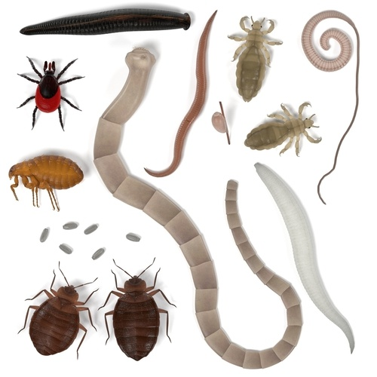
What is a parasite?
An organism that lives in or on an organism of another species (its host) and benefits by deriving nutrients at the other's expense.
Symbiosis
https://www.superpharmacy.com.au/blog/parasites-protozoa-worms-ectoparasites

Slide 3
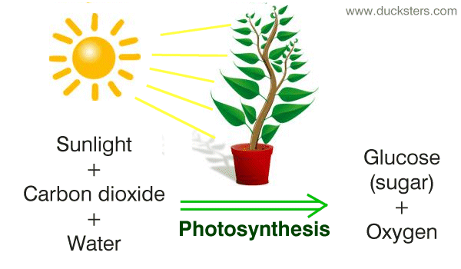
Food acquisition in plants: Autotrophy

Slide 4
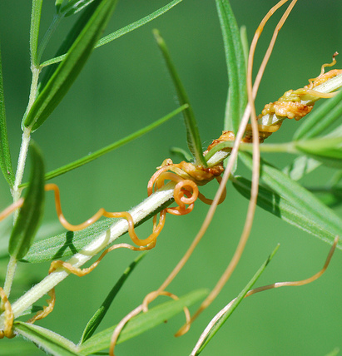
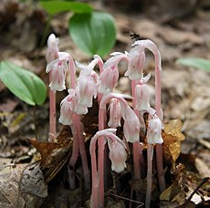
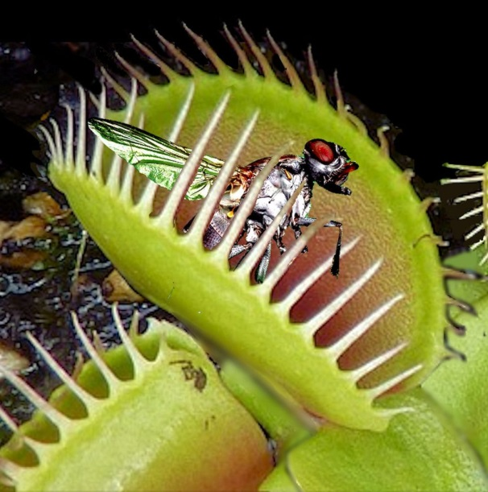
Heterotrophs (“different feeding”)
True parasites: obtain carbon compounds from host plants through haustoria.
Myco-heterotrophs: obtain carbon compounds from host plants via mycorrhizal fungal connection.
Carnivorous plants (not parasitic): obtain nutrients (phosphorus, nitrogen) from trapped insects.
Image Credit: Flickr User wackybadger, via CC
https://commons.wikimedia.org/wiki/File:Pink_indian_pipes.jpg
http://www.welivealot.com/venus-flytrap-facts-for-kids/
Notes:
Parasite is from the Greek para (beside) and sitos (grain or food) which literally means “beside the food”. If a plant also induces disease symptoms in a host, then it is a pathogen as well as parasite. A general term that refers to both parasites and mycotrophs that derive carbon from sources other than their own photosynthesis is heterotrophic, which simply means “different feeding.”

Slide 5
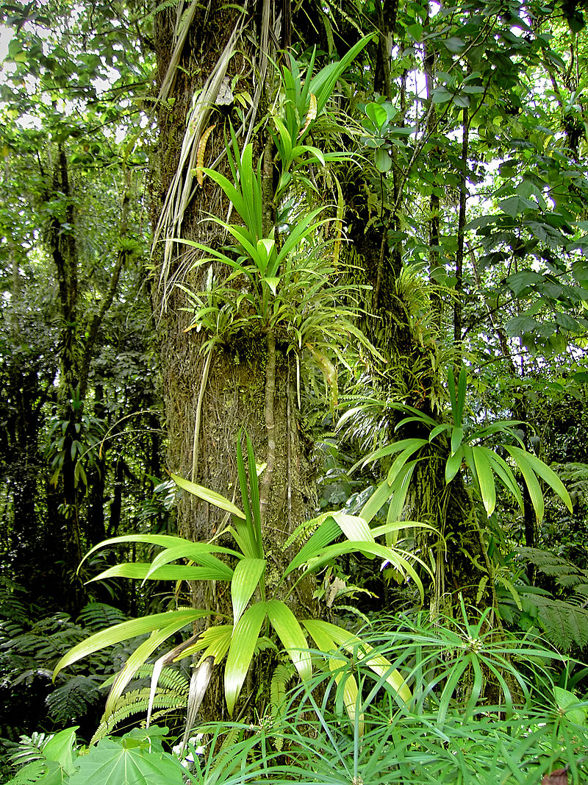
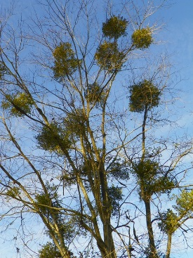
Parasite vs. Epiphyte
https://chatham.ces.ncsu.edu/2014/12/does-mistletoe-harm-trees-2/
By © Hans Hillewaert /, CC BY-SA 3.0, https://commons.wikimedia.org/w/index.php?curid=6289695

Slide 6
True Parasitic Plants
Gains all or part of its nutrition from another plant (the host).
Does not contribute to the benefit of the host and, in some cases, causing extreme damage to the host.
Specialized peg-like root (haustorium) to penetrate host plants.
https://www.britannica.com/plant/parasitic-plant
https://chatham.ces.ncsu.edu/2014/12/does-mistletoe-harm-trees-2/
Notes:
the haustorium, a specialized organ for host attachment, invasion, vasculature connection, and material transfer between the host and the parasite (Figure 1). The word haustorium comes from the Latin haustor or haurire, which means “water drawer.”

Slide 7
Diversity of parasitic plants
Eudicots
Parasitism has evolved independently at least 12 times within the plant kingdom.
Approximately 4,500 parasitic species in 28 families.
Found in eudicots and basal angiosperms
  1% of the dicot angiosperm species
  No monocot angiosperm species
Monocots
Basal angiosperms
Annu. Rev. Plant Biol. 2016.67:643-667
Notes:
Approximately 4,500 parasitic species belonging to 28 families, representing 1% of the dicotyledonous angiosperm species, have been reported (53). These parasitic species derived from 12 or 13 independent evolutionary events (143) and therefore show taxonomic diversity and morphological variation (Figure 1).

Slide 8
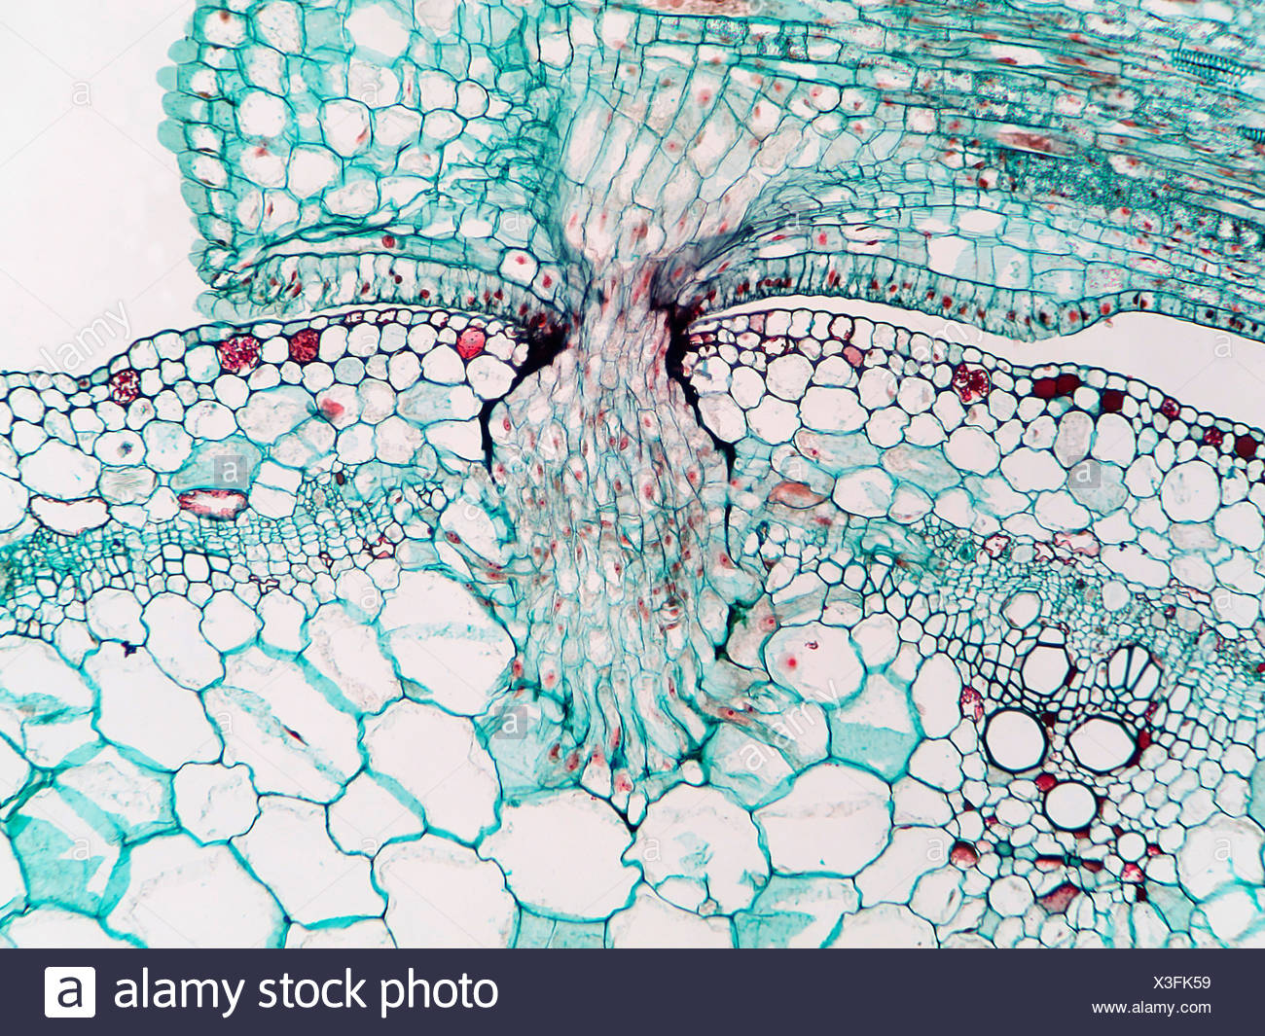
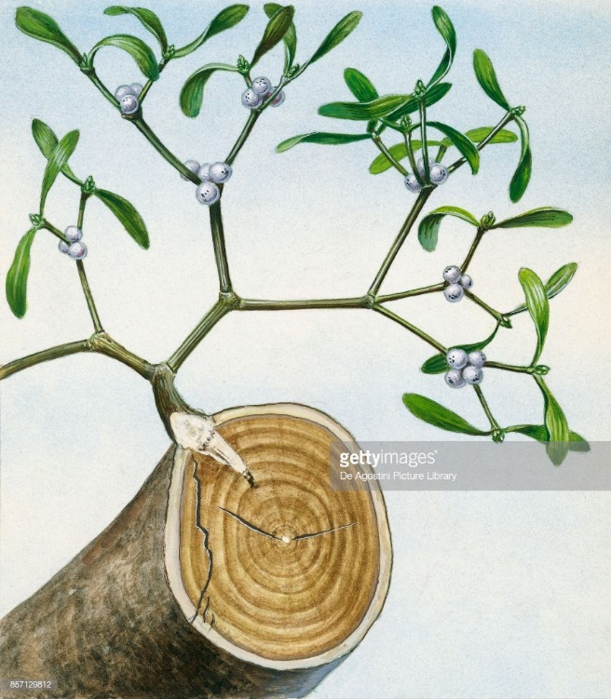
True Parasitic Plants
https://www.alamy.com/parasitic-dodder-plant-cuscuta-showing-penetration-parasitic-haustor
The defining structural feature of a parasitic plant is the haustorium.
https://www.gettyimages.com/detail/news-photo/mistletoe-plant-with-haustoria-in-the-trunk-of-the-host-news-photo/857129812
https://www.britannica.com/plant/parasitic-plant
Notes:
Haustoria are modified roots
the haustorium, a specialized organ for host attachment, invasion, vasculature connection, and material transfer between the host and the parasite (Figure 1). The word haustorium comes from the Latin haustor or haurire, which means “water drawer.”

Slide 9
i Root/stem ii (Pre)haustorium formation iii Invasion iv Host connection
The Haustorium, a Specialized Invasive Organ in Parasitic Plants. Annual Review of Plant Biology · April 2016
Notes:
Haustorium forms upon detection of haustorium-inducing factors derived from the host plant. Specialized hairs in the parasite roots secrete adhesive glues to anchor their haustoria to the host roots and to assist in penetration by providing mechanical forces toward the host tissue.
This organ penetrates into the host stem or root and connects to its vasculature, allowing exchange of materials such as water, nutrients, proteins, nucleotides, pathogens, and retrotransposons between the host and the parasite.

Slide 10
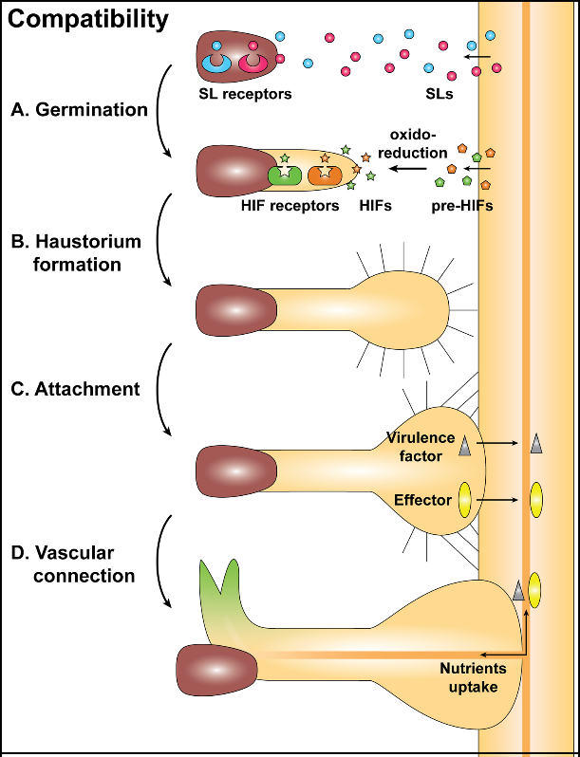
Haustorium formation
Sense and attach to host
  Recognize chemicals also used to attract symbiotic fungi and bacteria to plant roots
Penetrate host tissues
  Fragment and dissolve cell walls rather than crushing them
Avoid host immunity system
  Mimic pollen tube growth to avoid immunity activation
Develop vascular connection
  Lower water potential than host plant
Saucet SB, Shirasu K (2016) Molecular Parasitic Plant–Host Interactions. PLoS Pathog 12(12): e1005978. https://doi.org/10.1371/journal.ppat.1005978
Notes:
The haustorium has four main sequential functions: to attach to the host, to penetrate the host tissues, to avoid the host immunity system, and to develop a vascular connection between the host and parasite to absorb water and nutrients.
Recent comparative transcriptome analysis using three Orobanchaceae species also revealed adaptive changes in genes recruited from pollen tube development in parasitic lineages

Slide 11
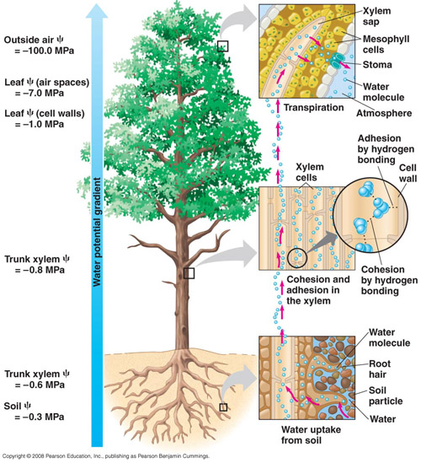
Water potential
Negative water potential causes water to evaporate from leaf
Cohesive forces pull water up from roots to replace lost leaf water

Slide 12
Water potential
Water and mineral nutrients move from a host to a parasite through the xylem connection.
A gradient of water potential between the host and parasite should drive the flow direction.
Solute accumulation, open stomata, or a combination of these could allow a parasitic plant to maintain a lower water potential than the host.

Slide 13
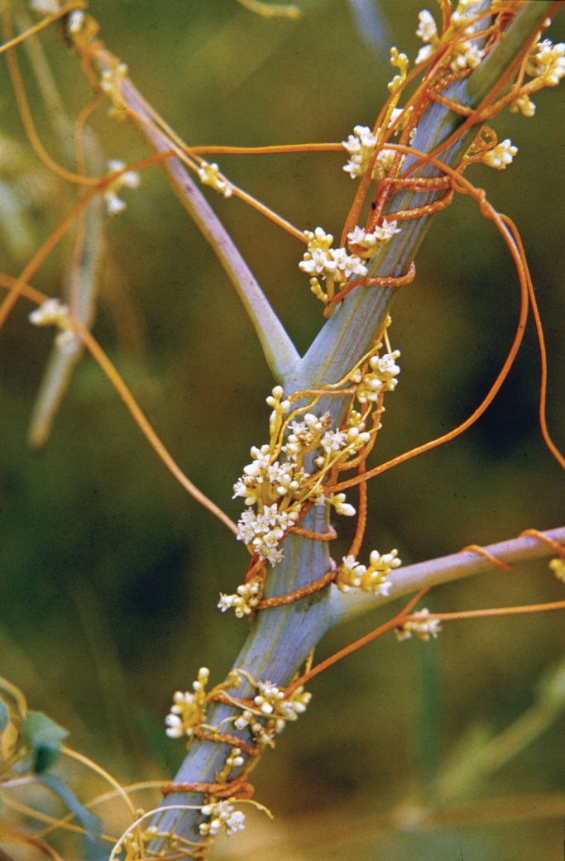
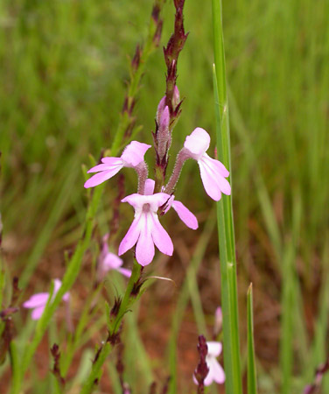
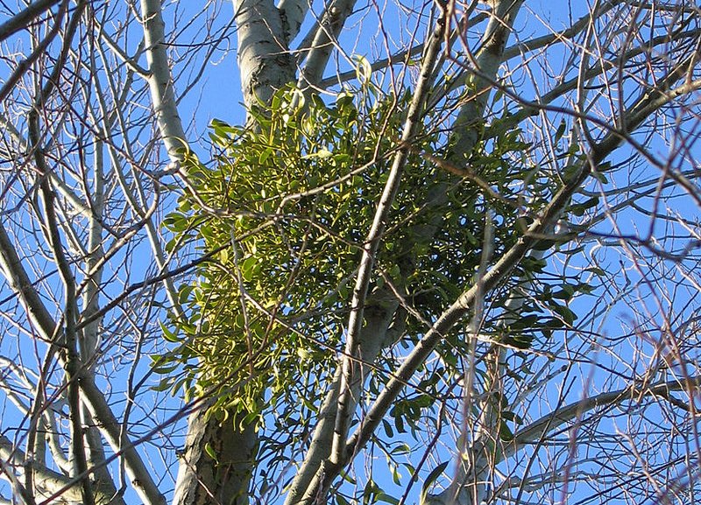
Life forms
Dodder (Cuscuta gronovii)
Witchweed (Striga bilabiata)
European mistletoe (Viscum album)
https://www.britannica.com/plant/parasitic-plant
CC BY-SA 2.0, https://commons.wikimedia.org/w/index.php?curid=34475
https://www.britannica.com/plant/parasitic-plant
Notes:
They occur in many life forms, including annual and perennial herbs (e.g. Rhinanthus spp. and Bartsia spp.), vines (e.g. Cuscuta spp. and Cassytha spp.), shrubs (e.g. Olax spp. and mistletoes) and trees (sandlewoods, e.g. Okoubaka aubrevillei, which grows up to 40 m tall; Veenendaal et al., 1996).

Slide 14
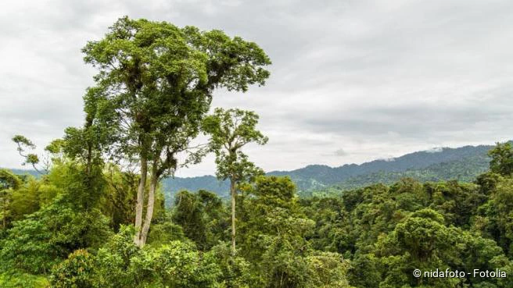
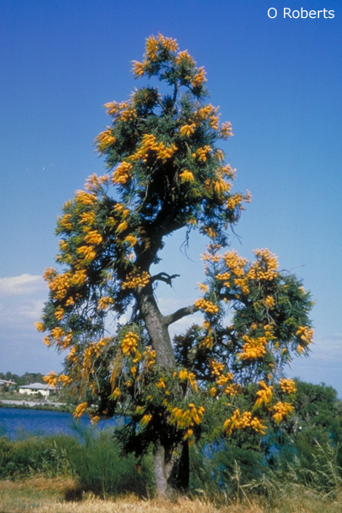
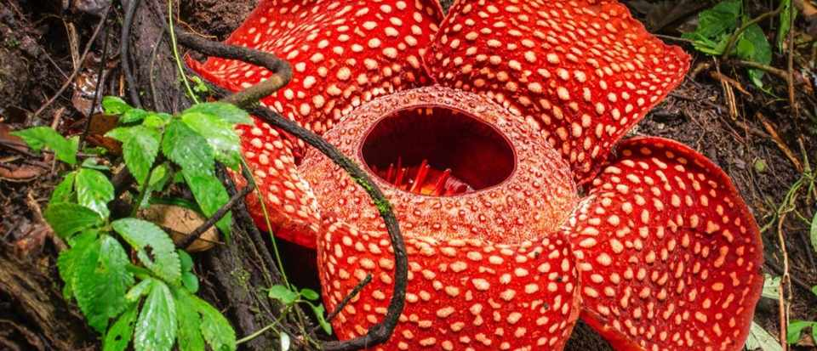
Life forms
Okoubaka aubrevillei
Death tree
Nuytsia floribunda
Western Australian Christmas Tree
https://www.netdoktor.de/homoeopathie/okoubaka/
Rafflesia spp.
Corpse flower
http://anpsa.org.au/n-flo.html
https://www.sciencefocus.com/nature/top-5-parasitic-plants/
Notes:
Nuytsia floribunda - It is a root hemiparasite, is photosynthetic and mainly obtains water and mineral nutrients from its hosts. The haustoria attach themselves to roots of many nearby plants and draw water and therefore nutrients from them.
sandlewoods, Okoubaka aubrevillei, which grows up to 40 m tall – no other trees appear to grow in proximity to this tree. It also provides an explanation as to why, among other things, the locals believe the tree to possess magical powers. Powered bark is used to counteract ingested poisions. “in his own country it is customary to take some of this powder following a meal – particularly if one not is entirely certain of the host’s friendship”
Rafflesia spp. - The plant has no stems, leaves or roots. It is a holoparasite of vines in the genus Tetrastigma (Vitaceae), spreading its absorptive organ, the haustorium, inside the tissue of the vine - In some species, such as Rafflesia arnoldii, the flower may be over 100 centimetres (39 in) in diameter, and weigh up to 10 kilograms (22 lb). Even one of the smallest species, R. baletei, has 12 cm diameter flowers.

Slide 15
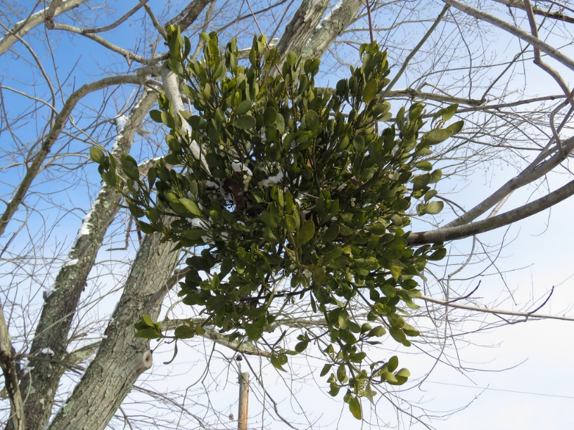
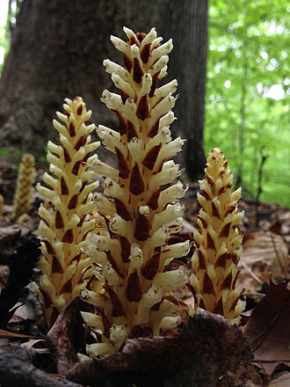
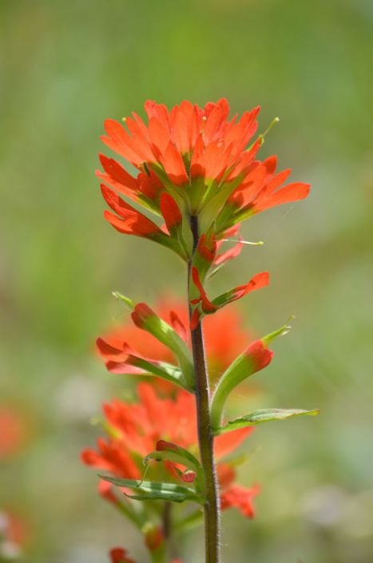
Types of parasitic plants
Attachment point
  Stem or root
Nutritional dependence
  Hemiparisite or holoparsite
Life cycle requirements
  Obligate or facultative
MBP: American Mistletoe in Harford Co., Maryland (12/16/2017). Photo by Josh Emm.
https://commons.wikimedia.org/wiki/File:Conopholis_americana_-_Bear_Corn.jpg
https://www.prairiemoon.com/castilleja-coccinea-indian-paintbrush-prairie-moon-nursery.html

Slide 16

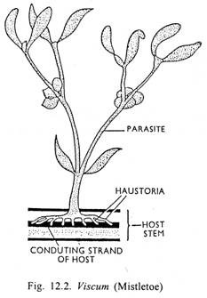
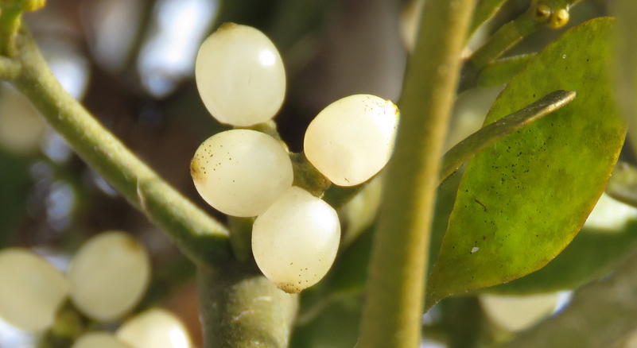
Attachment Point
Mistletoe – Phoradendron leucarpum
American/Eastern mistletoe
Stem parasites
MBP: American Mistletoe in Harford Co., Maryland (12/16/2017). Photo by Josh Emm.
MBP: American Mistletoe fruiting in Harford Co., Maryland (12/16/2017). Photo by Josh Emm. (MBP list)
Notes:
Phoradendron, a name derived from two Greek words meaning "tree thief." One species in Maryland.
Mistletoe seeds are covered with a musilaginous, glue-like substance called viscin that sticks to the bills of birds. In fact, it resembles rubber cement when the seeds are rolled between your fingers. When birds try to clean their bills, the seeds adhere to the limbs of other trees and shrubs. The seeds also pass through the bird's digestive tract and are transported from one bush to another in the bird's droppings.
Mistletoe: from two Germanic words: mista (dung) and tan (twig); referring to bird droppings on a branch or stem.
http://www.biologydiscussion.com/angiosperm/special-modes-of-nutrition-in-angiosperms-plant-physiology/23094

Slide 17
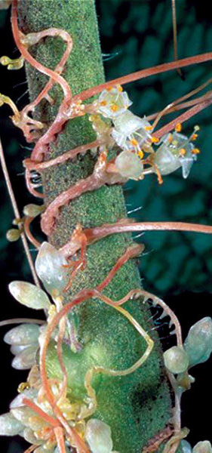
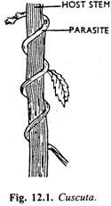
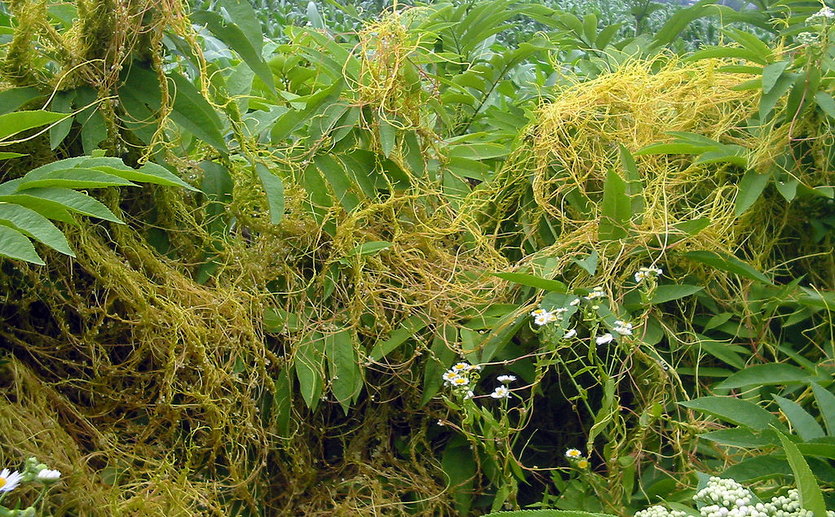
Attachment Point
Stem parasites
Dodder (Witches' hair ) – Cuscuta spp.
https://commons.wikimedia.org/w/index.php?curid=209875
Plant genetics: Gene transfer from parasitic to host plants. November 2004. Nature 432(7014):165-6
Notes:
http://www.biologydiscussion.com/angiosperm/special-modes-of-nutrition-in-angiosperms-plant-physiology/23094
Morning glory family. Nine species in the Flora of Virginia and MPB. Germinates in soil, forms small terrestrial root system that soon degenerates.

Slide 18
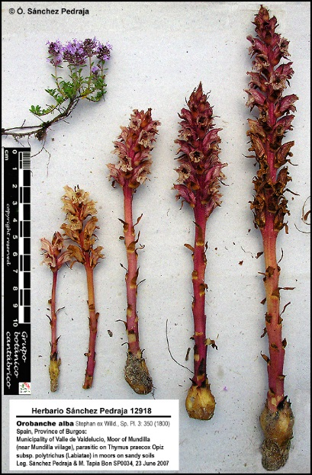
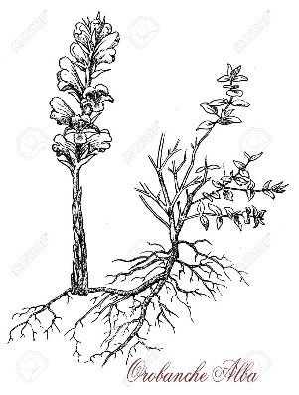
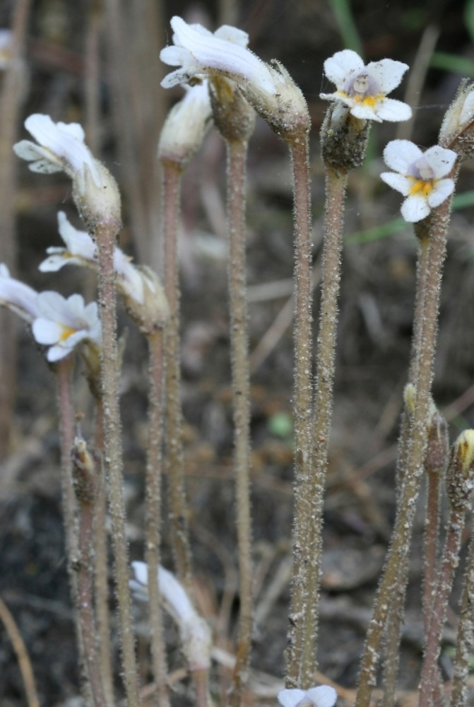
Attachment Point
Orobanche spp. (Broomrape)
Orobanche uniflora
Root parasites
By Arieh Tal. Copyright © 2019 Arieh Tal. botphoto.com
https://gobotany.newenglandwild.org/species/orobanche/uniflora/
https://www.123rf.com/photo_96361208_vintage-engraving-of-orobanche-alba-or-thyme-broomrape-parasitic-plant-with-stems-completely-lacking.html
http://www.farmalierganes.com/Flora/Angiospermae/Orobanchaceae/Orobanche/Orobanche_Grex_Glandulosae/Orobanche_alba/Orobanche_alba.htm
Notes:
Most are in the Orobanchaceae (broomrape family). Hemiparasitic members used to be in the Scrophularaceae.
English name broomrape because they were thought to grow as tubers (“rapum”) from brooms (the common name for the legume Cytisus).

Slide 19
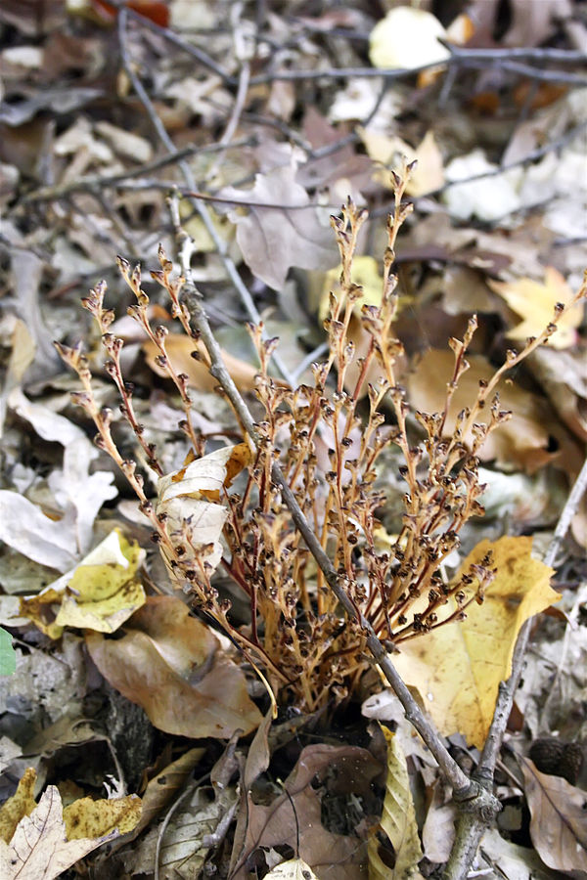
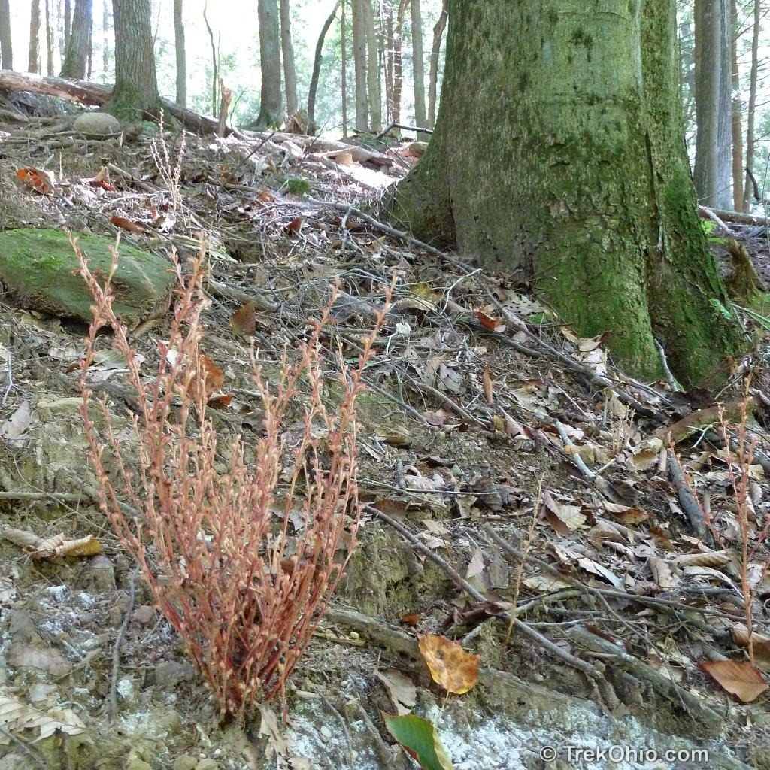
Attachment Point
Beech drops
Epifagus virginiana
Root parasites
https://trekohio.com/2012/09/24/beechdrops-our-third-plant-without-chlorophyll/
https://commons.wikimedia.org/wiki/File:Epifagus_virginiana.jpg
Notes:
Family: Orobanchaceae Beechdrops are used to monitor forest health because of their dependence on their host and the sensitivity to its environment.
The comparisons of the demographic histories of the host and the parasite strongly suggest that host density was the primary determinant in the parasite's range expansion and population genetics—not the host's own genetic patterns and migration routes.

Slide 20
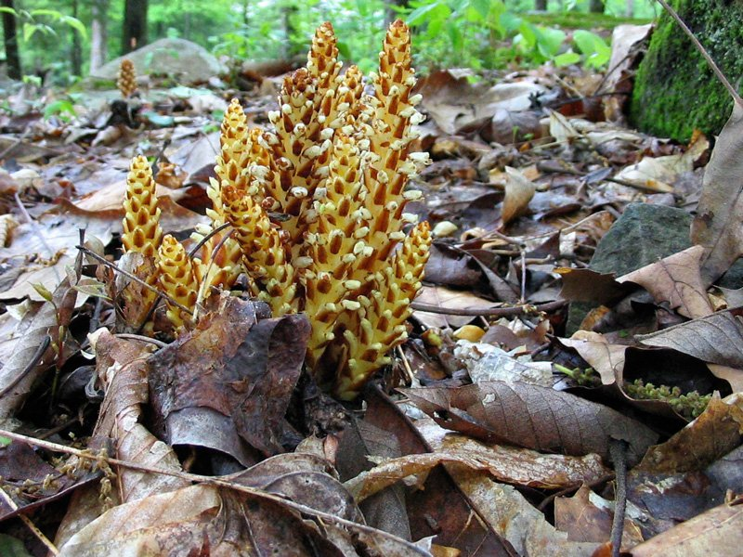
Attachment Point
Conopholis americana (Squawroot, Bearcorn)
Root parasites
https://commons.wikimedia.org/wiki/File:Conopholis_americana_-_Bear_Corn.jpg
https://botanyphoto.botanicalgarden.ubc.ca/2005/05/conopholis-americana/
Notes:
When blooming, resembles a pine cone or cob of corn growing from the roots of mostly oak and beech trees.
It is usually found in dense clumps of several erect stems and growing in shady forested sites.
The scientific name comes from the appearance of the erect stems which have numerous scale like flowers that look a bit like a pinecone, with conos meaning ‘cone’ and pholos meaning ‘scale’ in ancient Greek (Black and Judziewicz, 2008).
This dense inflorescence comes to the surface only after the parasite’s root system attaches to the oak root and forms a large woody gall and then builds up enough growth (about four years)

Slide 21
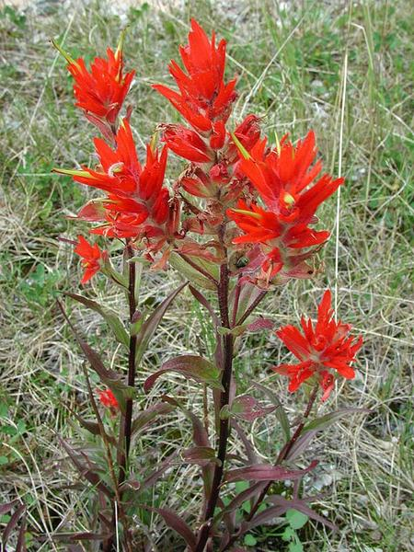
Attachment Point
Root parasites
Castilleja coccinea
Eastern Indian Paintbrush
https://www.prairiemoon.com/castilleja-coccinea-indian-paintbrush-prairie-moon-nursery.html
https://shop.sussexconservation.org/products/castilleja-coccinea-indian-paintbrush
Notes:
Orobanchaceae: Though it can survive on its own, studies indicate a forty-fold growth increase when its roots parasitize those of another plant for nutrients.^{[5]} It is primarily pollinated by ruby-throated hummingbirds who can transfer the pollen long distances between typically small and scattered populations of this plant.

Slide 22


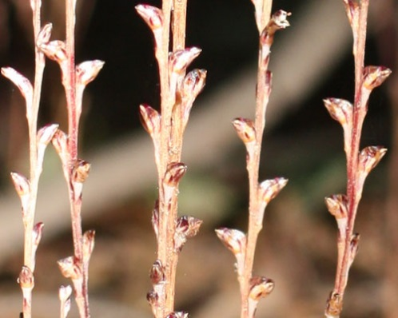
Nutritional Dependence
Holoparasite
Hemiparasite
https://commons.wikimedia.org/wiki/File:Conopholis_americana_-_Bear_Corn.jpg
MBP: American Mistletoe in Harford Co., Maryland (12/16/2017). Photo by Josh Emm.
https://commons.wikimedia.org/w/index.php?curid=209875
https://shop.sussexconservation.org/products/castilleja-coccinea-indian-paintbrush
By Arieh Tal. Copyright © 2019 Arieh Tal. botphoto.com
https://gobotany.newenglandwild.org/species/orobanche/uniflora/
Epifagus virginiana ( Beechdrops ) Gene G. King Park, Bridgewater, 9/17/2012, Photo H. & M. Ling
Notes:
20%–80% of hemiparasite biomass is derived from the host assimilates differing across species and developmental stages.
Numerous studies conducted in arid or semiarid conditions have thus demonstrated 50–80% proportion of host derived carbon in biomass of mistletoes.
The ability of hemiparasites to acquire organic carbon (largely in the form of xylem-mobile organic and amino acids)
In general, holoparasites tend to have leaves reduced to scales (or absent in Hydnoraceae), succulent stems, and a primary haustorium (derived from the seedling radicle). On the forest floor, little sunlight penetrates, hence nonphotosynthetic holoparasites such as Balanophoraceae and Rafflesiaceae can be found here.

Slide 23
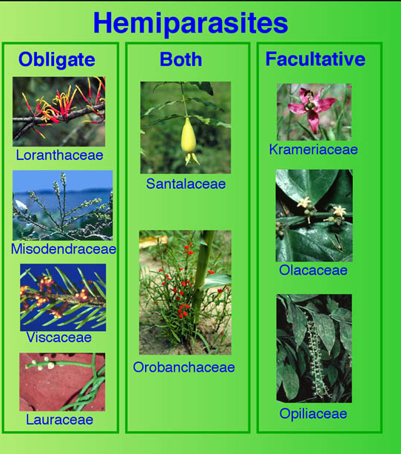
Life cycle requirements
Obligate
All holoparisites
All stem parasites (holoparasites and hemiparisites)
Some root hemiparisites
Facultative
Some root hemiparasites
https://parasiticplants.siu.edu/images/HoloHemiPars2.jpg
Notes:
Obligate Parasite. A plant that must attach to a host to complete its life cycle. All holoparasites are obligate whereas only some hemiparasites are obligate such as mistletoes and Striga asiatica.
Stem hemiparasites are attached to the host stem (usually trunk or branches) and are all obligate parasites, unable to survive without a host.
Facultative Parasite. A hemiparasitic plant that does not require a host to complete its life cycle. Note, however, that in nature, parasitism is nearly always observed. Many members of Orobanchaceae are facultative hemiparasites such as Agalinis, Aureolaria, and Seymeria. Some root parasites can complete life cycle without host but rarely do.

Slide 24
Generalists vs. specialists
Epifagus virginiana (beech drops)
Cuscuta spp. (dodder)
One host Fagus grandifolia
Hundreds of hosts in diverse families
https://commons.wikimedia.org/w/index.php?curid=209875
https://commons.wikimedia.org/wiki/File:Epifagus_virginiana.jpg
Notes:
Evidence exists that the generalist strategy has the greatest chance for survival over evolutionary time.
Most parasitic plants are generalists
Intriguingly, despite the large host range of the majority of parasitic plants, many also show high levels of host preference, such that while many different plant species within a community can act as hosts, the majority of hosts are taken from just a subset of those available
Better host: longer lived (woody), high nitrogen (legume), accessible vascular system, low defenses, better access to limiting resources (deep water in drought)

Slide 25


Biting the hand that feeds you
An organism that lives in or on an organism of another species (its host) and benefits by deriving nutrients at the other's expense.
Symbiosis
Notes:
all parasitic plant species have evolved under the constraint that they do not kill their hosts prior to successful reproduction.

Slide 26
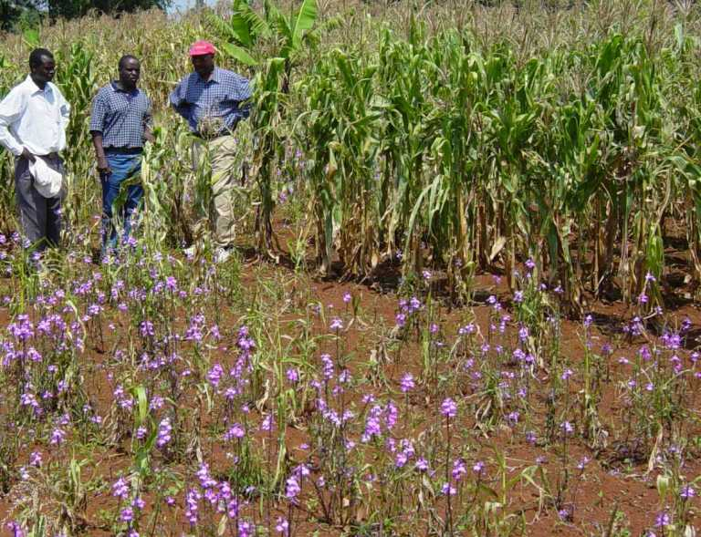
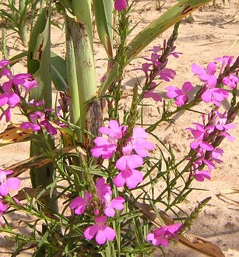
Striga hermonthica
(witchweed)
https://www.wur.nl/upload_mm/7/a/9/c3f2a783-b897-4464-b583-337e8d145594_Striga%20close-up%205_0c658f2c_490x330.jpg
Treated (back) vs. Un-treated (front)
https://pesticideguy.org/2014/10/09/herbicide-technology-can-reduce-massive-crop-losses-caused-by-parasitic-weeds-in-africa/
Notes:
Several parasitic plants are among the most devastating agricultural weed pests worldwide.
Most of the damage inflicted upon economically valuable hosts is caused by just four genera: Cuscuta, Arceuthobium, Orobanche, and Striga.
“Striga hermonthica (L.) Benth. or witchweed is a parasitic weed that attacks maize, sorghum, and pearl millet. The parasitic weed Striga causes yield losses of 30-80% on 2.5 million hectares of crops in Africa.
Striga infestations can become so severe in all major cereal producing regions of Africa that farmers will abandon their fields to cereal production and therefore large swathes of Africa will be precluded from becoming major cereal producing areas.

Slide 27
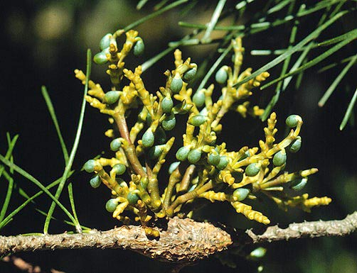
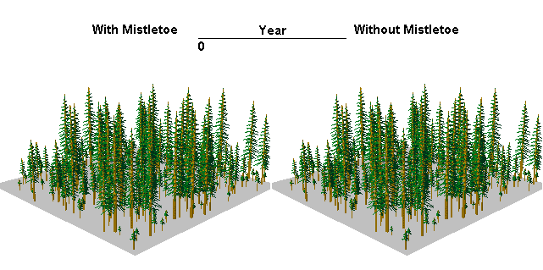
Arceuthobium
https://parasiticplants.siu.edu/Viscaceae/images/TSU.shorepine.JPEG
Model runs and image preparation by Lance David for Forest Health Technology Enterprise Team, USDA Forest Service, Fort Collins, CO. Copyright free.
Notes:
Animation of effects of dwarf mistletoe over 100 years in a Douglas-fir stand.
Gymnosperms
11.3 million cubic meters of wood in the western U.S.
$1.4 billion dollars in losses
1,000,000 homes per year!

Slide 28
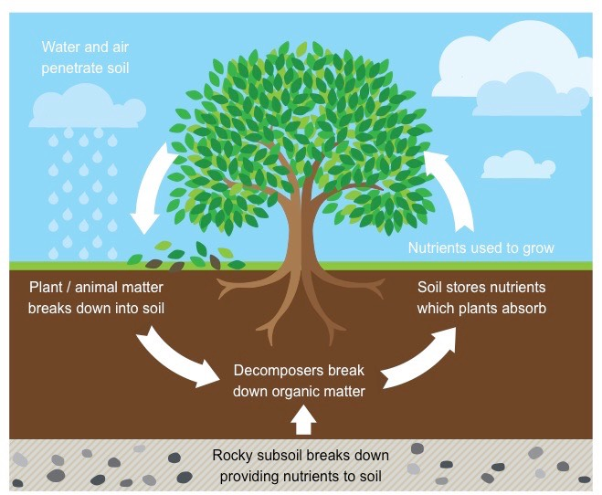
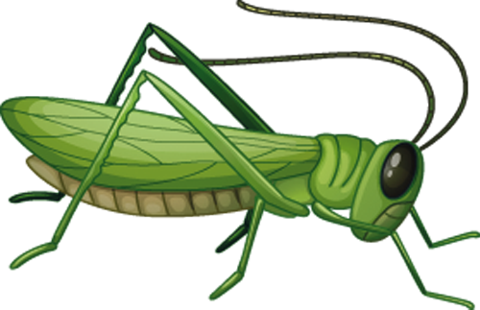
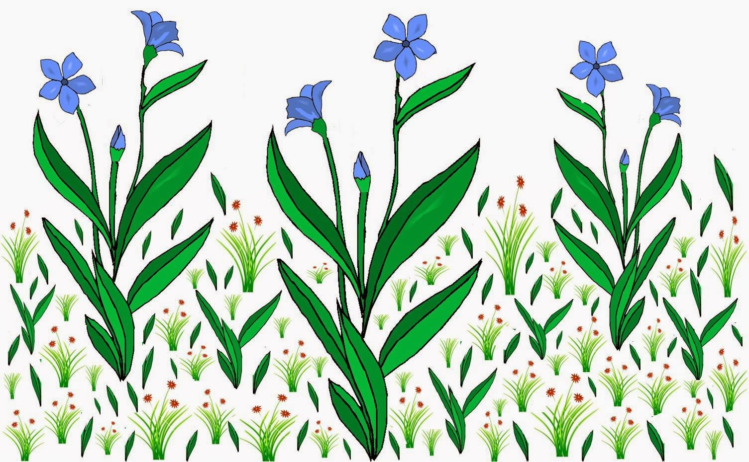
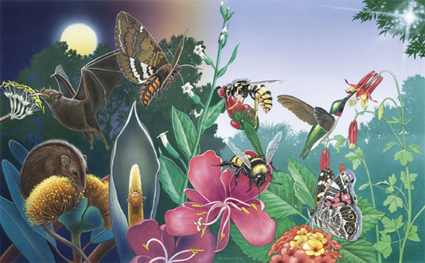
Impacts
http://ib.bioninja.com.au/_Media/nutrient-cycling_med.jpeg
http://www.musingsone.com/2015/02/the-size-advantage-hypothesis-for-plant.html
https://www.fs.fed.us/wildflowers/pollinators/
Notes:
Parasitism often severely reduces host performance, which leads to changes in competitive interactions between host and nonhost plants and a cascade of effects on community structure, diversity, vegetation cycling and zonation (Pennings & Callaway, 2002).
the uptake of host solutes can have consequences for organisms of other trophic levels (such as herbivores and pollinators), and co-occurring organisms may also be affected by the impacts of parasitic plants on the abiotic environment, including impacts on nutrient cycling, soil water relations, local temperature and atmospheric CO2 concentrations.

Slide 29
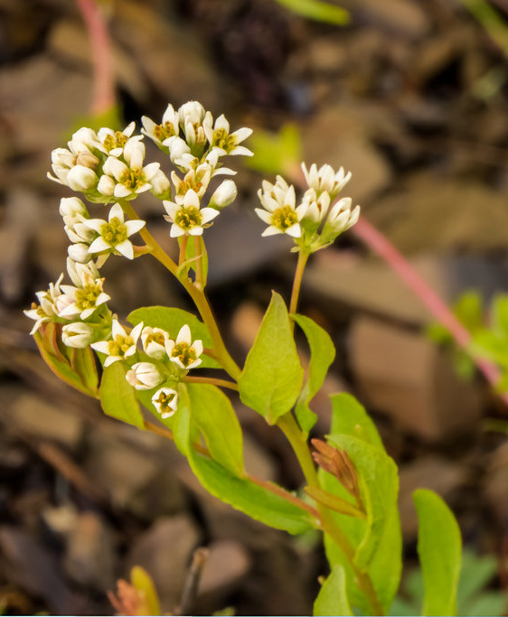
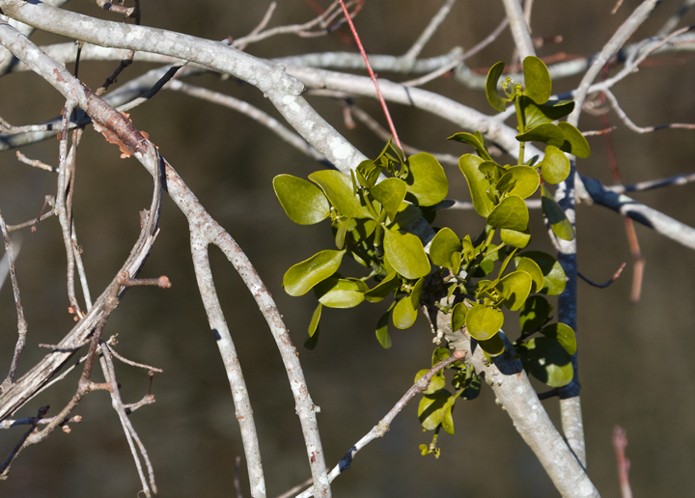
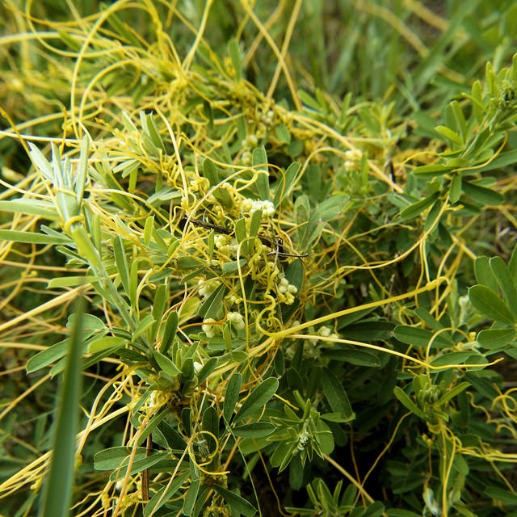
True parasites in Maryland
Bastard Toadflax Comandra umbellata
Five-angled Dodder Cuscuta campestris
American Mistletoe Phoradendron leucarpum
American Mistletoe growing on Red Maple in Somerset Co., Maryland (1/20/2013). Photo by Bill Hubick. (MBP list)
Five-angled Dodder in Anne Arundel Co., Maryland (6/25/2011). Photo by Bill Harms. (MBP list)
Bastard Toadflax blooming in Allegany Co., Maryland (5/19/2016). Photo by Ed Boyd. (MBP list)
Notes:
Family Santalaceae - Bastard Toadflax Comandra umbellata
Order Santalales > Family Viscaceae > Genus Phoradendron - American mistletoe
Order Solanales > Family Convolvulaceae > Genus Cuscuta - 9 species in MBP

Slide 30
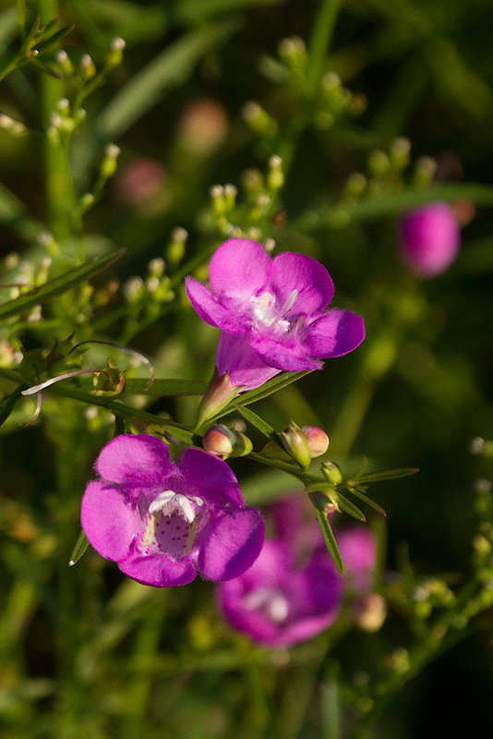
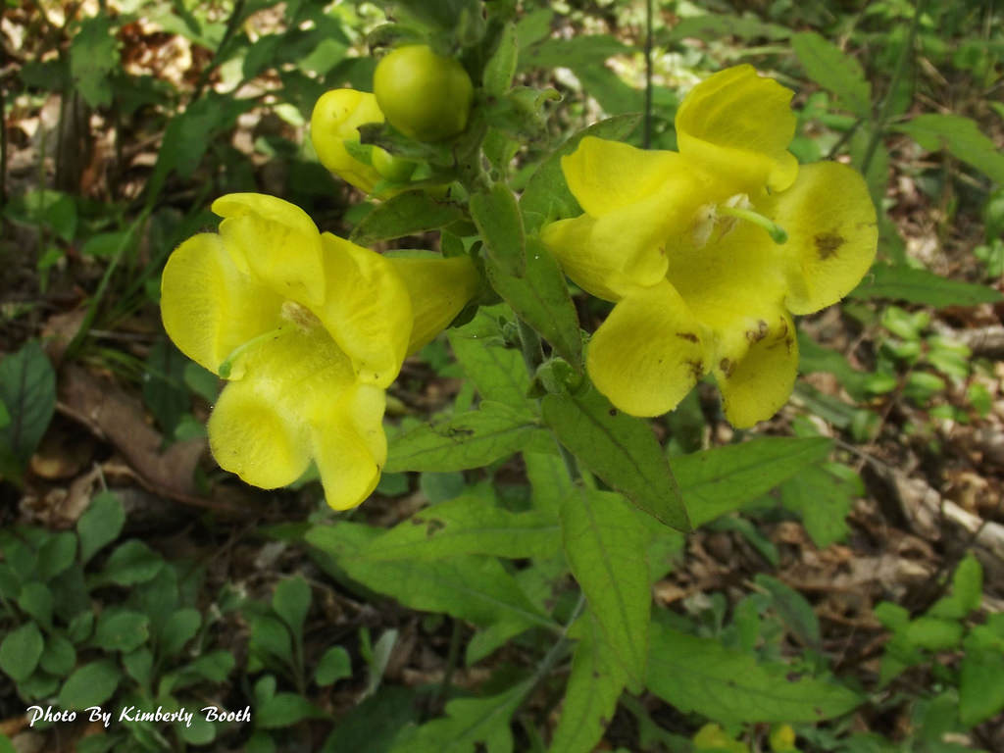
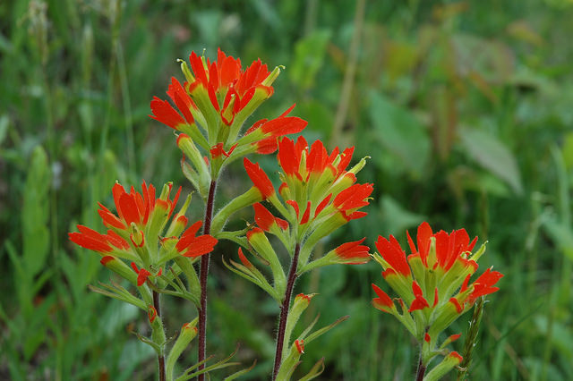
True parasites in Maryland
Purple Gerardia Agalinis purpurea
Downy Yellow False Foxglove Aureolaria virginica
Scarlet Indian Paintbrush Castilleja coccinea
Downy Yellow False Foxglove in Allegany Co., Maryland (6/30/2015). Photo by Kimberly Booth. (MBP list)
Purple Gerardia blooming on Assateague Island, Maryland (8/30/2013). Photo by Bill Hubick. (MBP list)
Scarlet Indian Paintbrush in Garrett Co., Maryland (5/28/2007). Photo by Gary Van Velsir. (MBP list)
Notes:
Orobanchaceae – hemiparasites used to be Scrophulariaceae
Aureolaria – 4 species in MBP
Scarlet Indian Paintbrush Castilleja coccinea – S1
Agalinis – 8 species in MBP. Several state rare or extirpated.

Slide 31
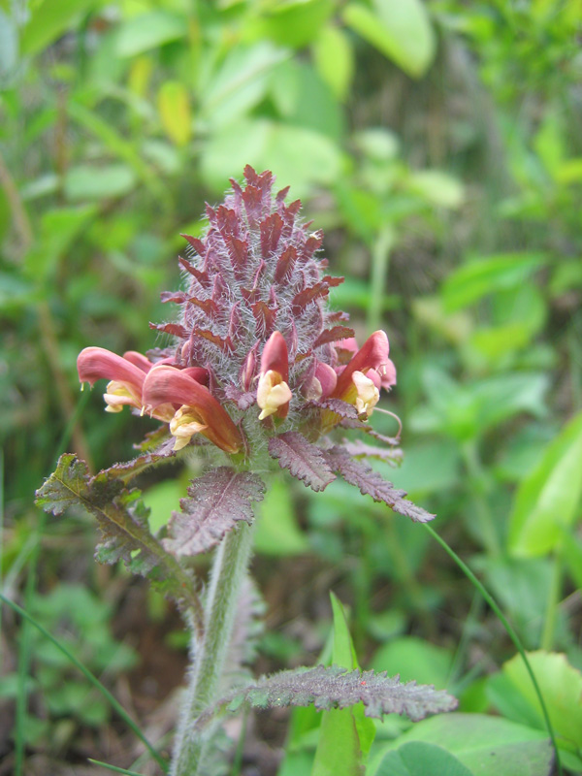
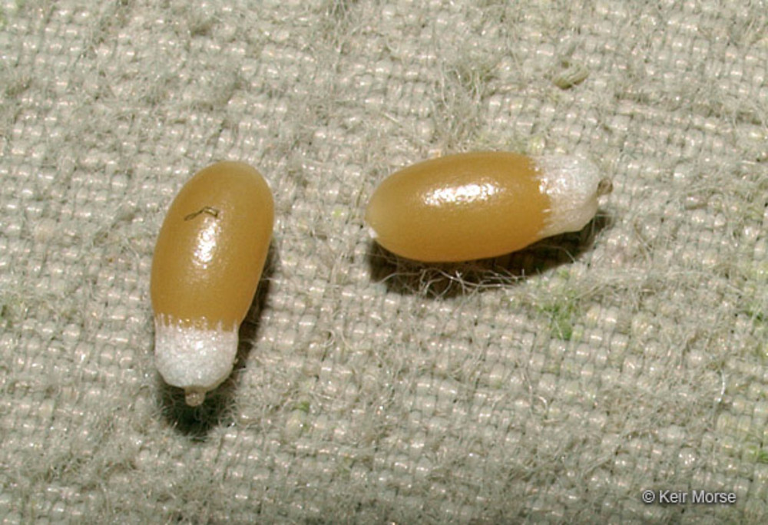

True parasites in Maryland
Canadian Lousewort Pedicularis canadensis
Narrow-leaved Cow-wheat Melampyrum lineare
elaiosome
Canadian Lousewort blooming in Garrett Co., Maryland (5/28/2007). Photo by Wayne Longbottom. (MBP list)
Narrow-leaved Cow-wheat blooming in Frederick Co., Maryland (7/8/2013). Photo by Bonnie Ott. (MBP list)
By Keir Morse. Copyright © 2019 Keir Morse.
www.keiriosity.com
Notes:
Melampyrum – 3 varieties of one species in MBP
Pedicularis – 2 species in MBP P. lanceolate is state rare

Slide 32



True parasites in Maryland
One-flowered Broomrape
Aphyllon (Orobanche ) uniflorum
Squawroot Conopholis americana
Beechdrops Epifagus virginiana
One-flowered Broomrape blooming in Cecil Co., Maryland (4/29/2017). Photo by Ashley Bradford. (MBP list)
Squawroot in Garrett Co., Maryland (5/22/2016). Photo by Robert Ferraro. (MBP list
Beechdrops in bloom in Howard Co., Maryland (10/2/2014). Photo by Nancy Magnusson. (MBP list)
Notes:
Conopholis – 1 species in MBP – parasite on Quercus
Epifagus virginiana – monotypic genus – common
Orobanche - One-flowered Broomrape Aphyllon uniflorum - native; Orobanche minor – invasive.

Slide 33
Heterotrophs (“different feeding”)
True parasites: obtain carbon compounds from host plants through haustoria.
Myco-heterotrophs: obtain carbon compounds from host plants via mycorrhizal fungal connection.
Carnivorous plants (not parasitic): obtain nutrients (phosphorus, nitrogen) from trapped insects.
Image Credit: Flickr User wackybadger, via CC
https://commons.wikimedia.org/wiki/File:Pink_indian_pipes.jpg
http://www.welivealot.com/venus-flytrap-facts-for-kids/
Notes:
Parasite is from the Greek para (beside) and sitos (grain or food) which literally means “beside the food”. If a plant also induces disease symptoms in a host, then it is a pathogen as well as parasite. A general term that refers to both parasites and mycotrophs that derive carbon from sources other than their own photosynthesis is heterotrophic, which simply means “different feeding.”

Slide 34

Myco-hetrotrophs
Notes:
https://3c1703fe8d.site.internapcdn.net/newman/gfx/news/2018/1-partialmycoh.jpg
mycoheterotrophs obtain their nutrition indirectly from the plant via a mycorrhizal fungus
Finally, mycoheterotrophs are sometimes mistakenly called saprophytes. There are no true saprophytes in the angiosperms. Only fungi can directly utilize dead organic material.

Slide 35

Mycorrhizal Fungi
Mycorrhiza means “fungus root” and was first used in 1885
95% of all plant species belong to a genera that characteristically form mycorrhizae.
Thought to have evolved with the first land plants
More prevalent in perennial plants than in annual plants

Slide 36


Ectomycorrhizae
Found in northern forests where decomposition is slow and nitrogen remains locked up in organic matter
Forms structures on the outside of plant roots (ecto)
Can often be seen with the naked eye
Reproduce by mushrooms
Oaks, Pines and Eucalyptus
Little specificity (either way)
  Douglas-fir reported to be associated with some 2,000 fungal species across its range

Slide 37


Endomycorrhizae (Arbuscular mycorrhizae)
Found in southern forests and grasslands where fast decomposition doesn’t limit nitrogen
Important for transferring phosphorus that binds to mineral soil particles
Forms structures on the inside of plant roots (endo)
Roots need to be stained to observe fungi
Reproduce by forming spores in the soil
Ancient association
Little specificity (either way)

Slide 38


Slide 39



Arbuscules

Slide 40


Parasite vs. Myco-heterotroph
Parasite
Symbiosis = Parasitism
Myco-heterotroph
Symbiosis = Mutualism
Symbiosis = Parasitism
Notes:
With few exceptions, myco-heterotrophic Aneuraceae, Orchidaceae and Ericaceae exploit ectomycorrhizal networks while myco-heterotrophic Burmanniaceae, Corsiaceae, Gentianaceae, Thismiaceae and Triuridaceae exploit arbuscular mycorrhizal networks
The majority of fully myco-heterotrophic flowering plants are restricted to the tropics, but myco-heterotrophic Ericaceae and some Orchidaceae occur in temperate forests.

Slide 41


https://en.wikipedia.org/wiki/File:Meuble_h%C3%A9raldique_aulne.svg
https://pixabay.com/en/mushrooms-toadstools-fungi-fungus-576065/
https://www.ncbi.nlm.nih.gov/pmc/articles/PMC2778383/
Notes:
physiological continuity is established among a photosynthetic mycorrhizal plant, a mycorrhizal fungus and a nonphotosynthetic mycorrhizal plant.
photosynthetic plant interacts only indirectly with the epiparasitic plant and the photosynthetic plant cannot select against the epiparasitic plant without selecting against a fungal mutualist.

Slide 42


Diversity of myco-heterotrophs
Obligate myco-heterotrophs
Dependent throughout lifetime
Facultative myco-heterotrotrophs
Only during establishment phase
https://www.kings.co.nz/userfiles/Editorial/orchids/orchid-seed-germinating.jpg
Mycoheterotrophy: The Biology of Plants Living on Fungi
Notes:
New Phytologist (2005) 167 : 335–352
A further distinction is made between plants that are myco-heterotrophic only during their establishment phase (e.g. most, if not all, Orchidaceae, many ferns
and lycophytes), and those that are obligately myco-heterotrophic throughout their lifetime (e.g. some Orchidaceae and Gentianaceae, all Monotropoideae and Triuridaceae).
( a ) Voyria clavata (Gentianaceae). ( b ) A large clump of Epirixathes plants (Polygalaceae) from Malaysian Borneo. ( c ) Voyria tenuiflora (Gentianaceae) photographed in French Guiana by Heiko Hentrich. ( d ) Allotropa virgata (Ericaceae) in Umqua Forest, Oregon, USA. ( e ) Sarcodes sanguinea (Ericaceae) at Lassen Volcanic National Park in California, USA

Slide 43

Diversity
Initial MHT
  20,000 spp.
  Orchids, ferns, lycophytes
Full MHT
  500 spp.
  some Orchidaceae and Gentianaceae,
  all Monotropoideae and Triuridaceae
Notes:
Full myco-heterotrophy evolved independently over 40 times within plant lineages and it has been confirmed in liverworts, monocots and eudicots.
Lineages of plants that have evolved myco-heterotrophy (dashed branches).
Lineages with full myco-heterotrophs are shown in bold (c. 500 spp.). The rest contain initially myco-heterotrophic plants only (c. 20 000 spp.).
Asterisks indicate lineages for which some molecular identification of mycorrhizal fungi has been carried out.
extant obligate plant cheaters of mycorrhizas have evolved independently multiple times (at least once in liverworts, perhaps once in ferns and in gymnosperms, probably tens of times in monocots and at least four times in dicots).
(ii) mycorrhizas have been investigated in very few of the putative myco-heterotrophic plants; and
(iii) myco-heterotrophic plants spend most of their life cycle underground, many are ephemeral and small, and new lineages are still being discovered.

Slide 44


Parasitaxus usta
https://www.flickr.com/photos/tim-waters/349306324/in/photolist-wShAQ-4esgmy/
http://stanhopea-passion.over-blog.com/
Notes:
Forests of New Caledonia - P. usta utilized a fungal intermediary to parasitize the roots of its only known host, another member of the Podocarpaceae family, Falcatifolium taxoides.
It is a very difficult plant to locate in the wild and, because it can be killed simply by stepping on the delicate shoots that are often concealed beneath forest litter,
The transfer of carbon (sugars) from the host plant is achieved mainly through a fungal intermediary, as in the case of mycoheterotrophs such as the nonphotosynthetic ericads pinesap (Hypopitys) and indian-pipe (Monotropa), but a direct xylem connection with the host may also occur and may facilitate nitrogen tranfer from the host. The plant also has a high stomatal conductance and low water potential, like the mistletoes. Thus it has a unique form of parasitism unlike any other known plant.

Slide 45

Hypopitys monotropa
yellow pine-sap
1821
Is M. hypopithys ‘parasitic on the roots of other plants?’
https://gobotany.newenglandwild.org/species/hypopitys/monotropa/
Notes:
1881 Kamienski Monotropa is nourished by a fungus linked to tree roots.
1885 Frank Definition of mycorrhizas.
1892 Frank Monotropa is parasitic upon the fungus attached to its roots.
1894 Frank Mycorrhizal fungi benefit Pinus growth.
1934 Francke Fungi penetrate epidermal cells of Monotropa. Successful germination of Monotropa seeds.
1960 Björkman Monotropa is an epiparasite on the ectomycorrhizas of trees.
Physical separation from tree roots showed a marked reduction in M. hypopithys growth, and radioactive isotope labeling revealed greater translocation of carbon and phosphorus from Picea to Monotropa than to any other neighboring plants.

Slide 46

Monotropa uniflora
(Ghost plant, Indian pipe)
A. Mature plants in the field
B. Root system showing the typical cluster of mycorrhizas.
C. Individual mycorrhizal root tip.
D. Transversal section of a mycorrhiza showing a pseudoparenchymatous mantle, brown tannin layer, Hartig net surrounding epidermal cells, and the hyphal peg (arrow head) penetrating an epidermal cell.
Russulaceae Associated with Mycoheterotroph Monotropa uniflora (Ericaceae) in Tlaxcala, Mexico: A Phylogenetic Approach December 2015. Cryptogamie Mycologie 36(4):479-512

Slide 47
Successful exploiters of the ectomycorrhizal symbiosis ultimately evolved from mutualists via defection.
Exceptionally high specificity of myco-heterotrophic plants towards narrow clades of ecto- and arbuscular mycorrhizal fungi relative to autotrophic plants.
Are nonphotosynthetic mycorrhizal plants parasitic?
  If they supply nutrients, then no.

Slide 48
Fully mycoheterotrophic species in monocots
Fully mycoheterotrophic species in eudicots
Notes:
myco-heterotrophy makes it possible to succeed in the low-light conditions of understory habitats. In fact, most, if not all, nonphotosynthetic mycorrhizal plants
are understory woodland inhabitants and, at least in the Ericaceae (Cullings et al ., 1996), they most likely evolved from photosynthetic mycorrhizal plants that inhabited understory woodland habitats.

Slide 49



Myco-heterotrophs in Maryland
Spotted Coralroot Corallorhiza maculata
American Wintergreen Pyrola americana
Spotted Wintergreen Chimaphila maculata
Spotted Coralroot flowers in Iron Co., Wisconsin (8/1/2008). Photo by Corey Raimond. (MBP list)
Spotted Wintergreen in Frederick Co., Maryland (6/28/2015). Photo by Bob Cammarata. (MBP list)
American Wintergreen blooming in Montgomery Co., Maryland (6/15/2016). Photo by Robert Ferraro. (MBP list)
Notes:
Family Orchidaceae > Genus Corallorhiza - 4 in MBP – some rare
Ericaceae - Chimaphila – 2 species – partially mycoheterotrophic
Ericaceae - American Wintergreen Pyrola americana

Slide 50




Myco-heterotrophs in Maryland
Virginia Pennywort Obolaria virginica
Indian Pipe Monotropa uniflora
Pinesap Monotropa hypopithys
Virginia Pennywort in Montgomery Co., Maryland (4/26/2015). Photo by Mike Ostrowski. (MBP list)
Pinesap in St. Mary's Co., Maryland (6/30/2018). Photo by Bill Hubick. (MBP list)
Pygmy Pipes Monotropsis odorata
Indian Pipe in Cecil Co., Maryland (9/21/2014). Photo by Beth Johnson. (MBP list
Notes:
All Ericaceae
Pygmy Pipes Monotropsis odorata Schweinitz ex ElliottEndangered (MD) - S1 (Highly state rare) - Vulnerable Southeast US, Maryland at northern end of range. Specimens in Smithsonian from Baltimore and Anne Arundel Counties.
Gentianaceae: Virginia Pennywort - It is native to the eastern United States,^{[2]} where it is found in nutrient-rich forests. It is believed to be mycoheterotrophic, getting much of its nutrients though a symbiotic relationship with fungi, instead of through its small purplish-green leaves.[

Slide 51

Western Spotted Coralroot - Corallorhiza maculata
On Going Unnoticed by Robert Frost
As vain to raise a voice as a sigh
In the tumult of free leaves on high.
What are you in the shadow of trees
Engaged up there with the light and breeze?
Less than the coral-root you know
That is content with the daylight low,
And has no leaves at all of its own;
Whose spotted flowers hang meanly down.
You grasp the bark by a rugged pleat,
And look up small from the forest's feet.
The only leaf it drops goes wide,
Your name not written on either side.
You linger your little hour and are gone,
And still the wood sweep leafily on,
Not even missing the coral-root flower
You took as a trophy of the hour.
http://www.digitalnaturalhistory.com/genus_corallorhiza_index.htm

